Slide 1
Version Control With Git
What you are going to learn.
At the end of this module you will be able to:
Install Git and work with remote repositories.
Learn how organization implement Code Merge Strategies'
How to create Pull request in GUI & CLI.
How to create Web hook in GitHub and Jenkins.
Learn about Branch permissions.
Execute branching and merging operations.
Perform various Git commands.
Satyam Kumar Pandey
DevopsTraining@2020

Slide 2
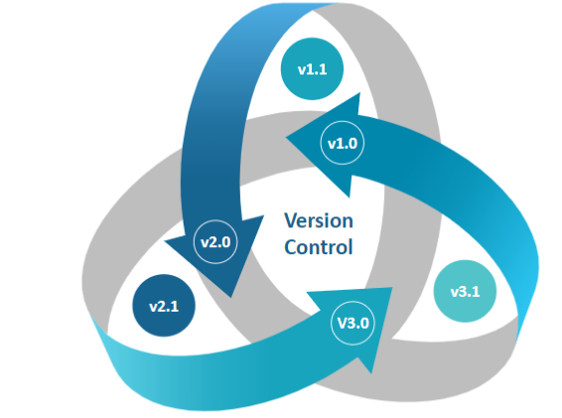
Version Control With Git
Git is a version control
What is Version Control?
Git Version control is a system that records changes to a file or set of files over time so that you can recall specific versions later.
Or
Version Control System allows developers to manage the code and it will enable the developers to work separately on their tasks using branches and collaborate it to contribute their changes in the code base of the project.
Satyam Kumar Pandey
DevopsTraining@ 2020

Slide 3
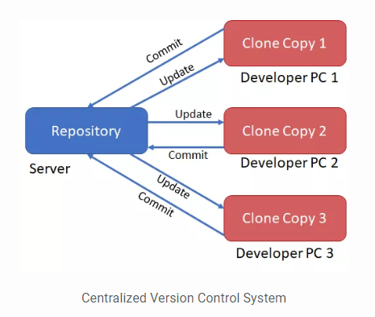
Version Control With Git
Centralized Version Control
Version Control: Types
The centralized Version Control System will have the master copy of the Code base the Server Repository and Developer can get the clone copy of the repository.
Developers will change the code and directly they will commit into the Server Repository
Centralized
Distributed
Satyam Kumar Pandey
DevopsTraining@2020
Notes:
The centralized Version Control System will have the master copy of the Code base the Server Repository and Developer can get the clone copy of the repository. Developers will change the code and directly they will commit into the Server Repository

Slide 4
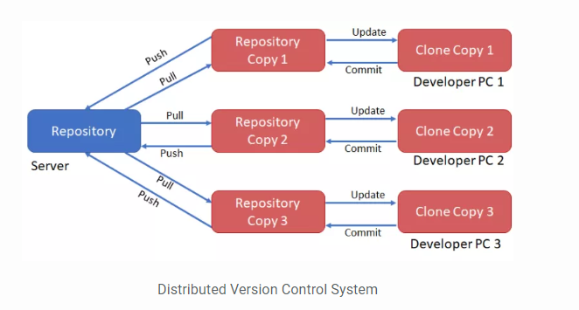
Version Control With Git
Distributed Version Control
Version Control: Types
The Distributed Version Control System will have the master copy of the Code Base in Server Repository and Developer can get a copy of the repository to maintain in his PC or the workstation.
For every small changes, Developer can pull/download the code to local repository and once the job is done, Developer can push the code to Server Repository.
Centralized
Distributed
Satyam Kumar Pandey
DevopsTraining@2020
Notes:
The Distributed Version Control System will have the master copy of the Code Base in Server Repository and Developer can get a copy of the repository to maintain in his PC or the workstation. For every small changes, Developer can commit the code to local repository and once the job is done, Developer can push the code to Server Repository.

Slide 5
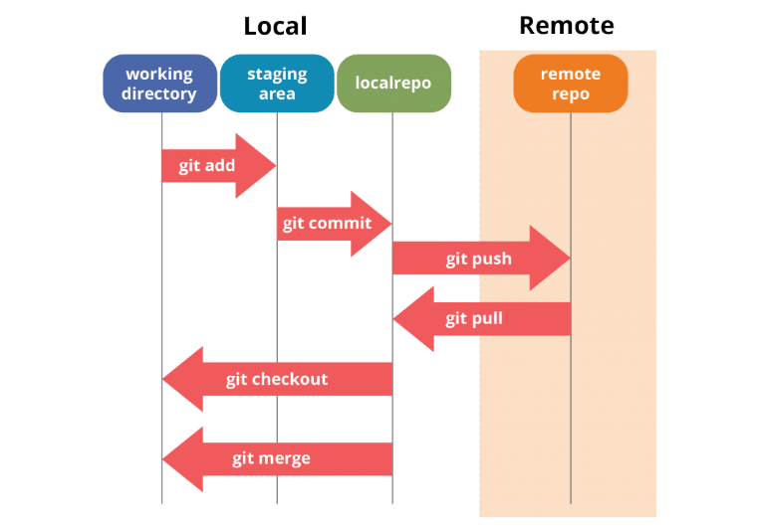
Version Control With Git
Distributed Version Control
Some of the basic operations in Git are:
Initialize
Add
Commit
Pull
Push
Some advanced Git operations are:
Branching
Merging
Rebasing
Satyam Kumar Pandey
DevopsTraining@2020
Notes:
git add --all
git commit --m "hello"
git push origin master
Local –GIT
Remote -Github

Slide 6

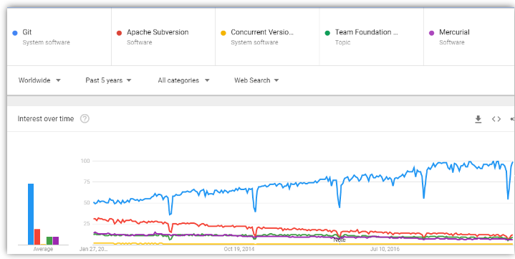
Version Control With Git
Why Git ?
Seems like Git is the most popular version control Tool.
Note : Above graph shows the usability of the popular VCS tools in the past 5 year
Satyam Kumar Pandey
DevopsTraining@December2018

Slide 7





Version Control With Git
What is Git?
Git is currently the most popular implementation of a distributed version control system.
Git is a free, open source distributed version control system tool designed to handle everything from small to very large projects with speed and efficiency.
It was created by Linus Torvalds in 2005 to develop Linux Kernel.
Git has the functionality, performance, security and flexibility that most teams and individual developers need.
Secure
Speed
Distributed Development
Easy branching
Scalable
Satyam Kumar Pandey
DevopsTraining@December2018

Slide 8
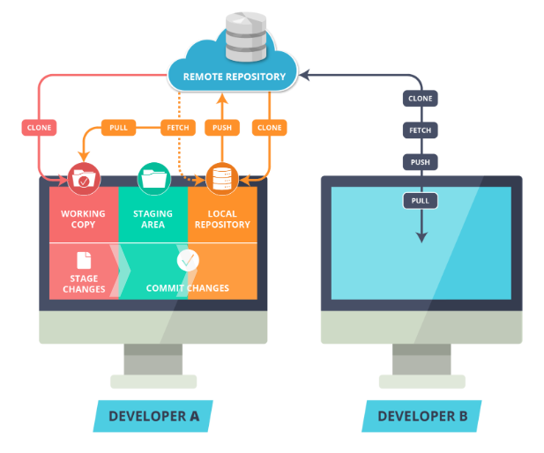
Version Control With Git
Git File Workflow
Learn How to work with Git.
Remote Repository
Local Repository
Working Copy or Workplace
Staging Area or Stage
Clone Command
Commit Command
Push Command
Pull Command
Fetch Command
Satyam Kumar Pandey
DevopsTraining@December2018

Slide 9
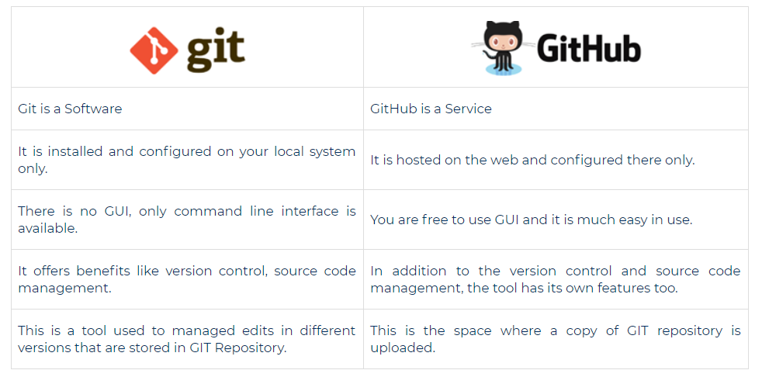
Version Control With Git
Is Git and GitHub are same?
Satyam Kumar Pandey
DevopsTraining@December2018

Slide 10
Version Control With Git
How to push changes from local to remote
Before you make changes to any branch, first download the latest changes from remote repo # git pull origin dev
#git branch
#git status
#git add –all or git add hello.java – workingdir to staging area
#git commit --m “upgrading k8s from v1.22 to v1.23“ – staging are to local repo
#git push origin master – local to remote repo
Defaut branch of remote repo is master or main
When ever you create a repo in the GitHub by default it will create master branch
How to download changes from remote to local
#git branch
*dev
#git pull origin dev
#git checkout –b bugfix/gat123
------
#git add –all
#git commit –m “hello”
#git push origin bugfix/gat123
#git pull origin master
#git pull branch_name
Satyam Kumar Pandey
DevopsTraining@December2018

Slide 11
Version Control With Git
Working on Branch !
Git branch
git branch : List all of the branches in your repository.
git branch -d staging : Delate merged Local Branch
git branch -D staging : Delete Unmerged Local Branches .
Git checkout
git checkout : it will be used when you want to change from one branch to another
git checkout -b feature/GAT-1234 : if I want to create a local branch
git checkout -b bugfix/GAT-1235
Git merge
git merge is used to combine two branches.
git checkout feature/GAT-1234
git merge <name of the branch which need to merge in master branch>
Git config
git config --global user.name “Satyam Pandey"
git config --global user.email satyam@gmail.com
Satyam Kumar Pandey
DevopsTraining@December2018
Notes:
To create a branch locally
You can create a branch locally as long as you have a cloned version of the repo.
From your terminal window, list the branches on your repository.
$ git branch * master
This output indicates there is a single branch, the master and the asterisk indicates it is currently active.
Create a new feature branch in the repository
$ git branch <feature_branch>
Switch to the feature branch to work on it.
$ git checkout <feature_branch>
You can list the branches again with the git branch command.
Commit the change to the feature branch:
$ git add . $ git commit -m "adding a change from the feature branch"
Switch back to the master branch.
$ git checkout master
Push the feature branch to Bitbucket:
$ git push origin <feature_branch>
View the Source page of your repository in Bitbucket. You should see both the master and the feature branch. When you select the feature branch, you see the Source page from that perspective. Select the feature branch to view its Recent commits.
==================
#git checkout master
#git checkout staging
#git checkout dev
#git checkout –f dev

Slide 12
Version Control With Git
Sync Operation in GIT
Git fetch
#git fetch origin development
Kisi bhi remote branch ko local me dowanload karna ho to fetch use karege.
Git push
#git push origin development
Local repo to remote repo
Git pull
#git pull origin development
Remote branch to local branch
Git password
git config --global credential.helper store
If you don’t want to provide the password multiple time, then you have use this command,
Satyam Kumar Pandey
DevopsTraining@December2018
Notes:
Branches
Up until now we have not created any branch in Git. By default, Git commits go into the master branch.
What is a branch?
A branch is nothing but a pointer to the latest commit in the Git repository. So currently our master branch is a pointer to the second commit “demo.txt file is modified”.
Why are multiple branches needed?
Multiple branches are needed to support multiple parallel developments. Refer the image below to see how branches work.

Slide 13
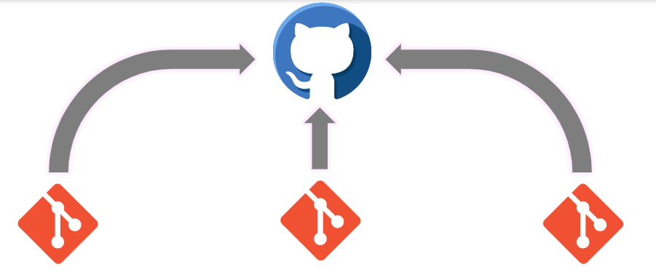
Version Control With Git
What is A Remote Repository?
Mostly all developer work on a local repository, But in order to collaborate with other developer, we use a remote repository. A remote repository is place where the users upload and share their commits with other developers.
Satyam Kumar Pandey
DevopsTraining@December2018

Slide 14
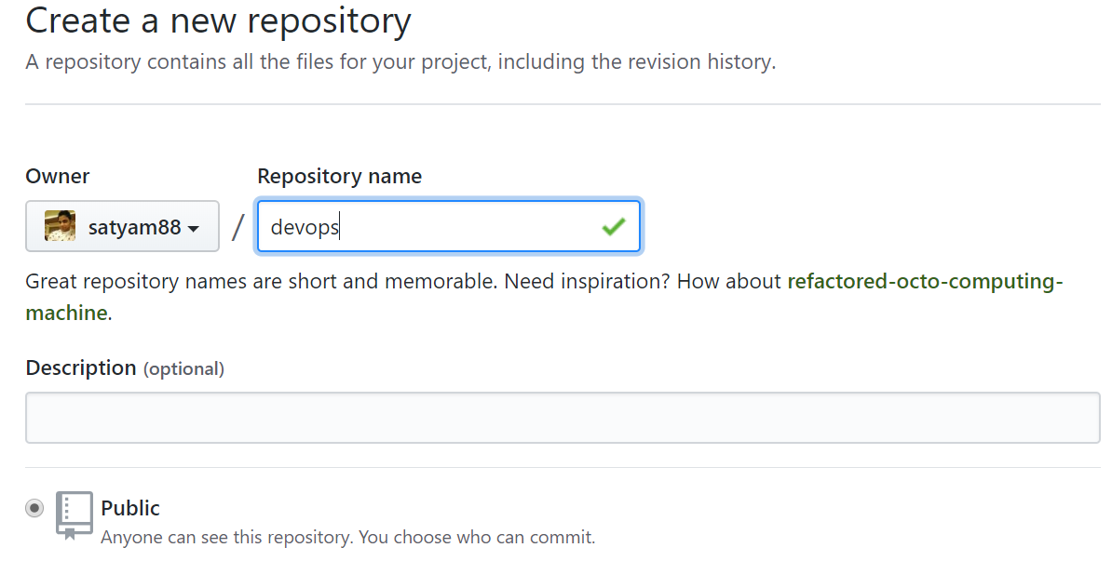
Version Control With Git
Creating A Remote Repository : New Repository
Sign-up at www.github.com
Click on New repository to create a new repository
Under Repository name, give a name to you repository
Give Some Description about your repository Under Description section.
Satyam Kumar Pandey
DevopsTraining@December2018

Slide 15
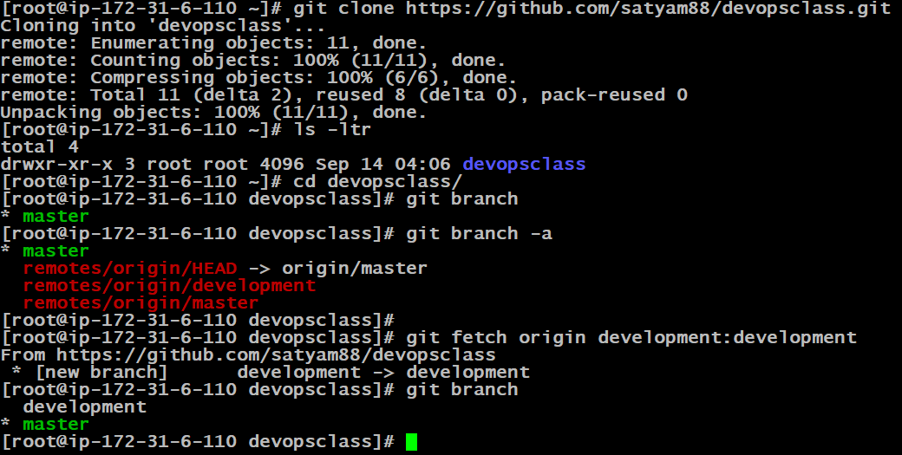
Version Control With Git
Cloning a Remote Git Repository
Satyam Kumar Pandey
DevopsTraining@December2018

Slide 16
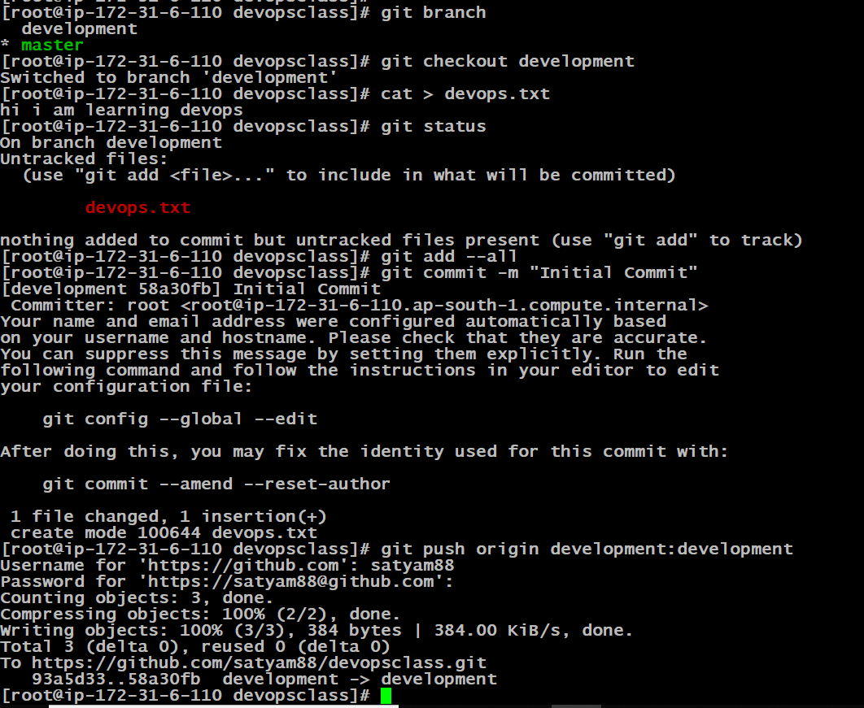
Pushing Source Code to Github Repository
Satyam Kumar Pandey
DevopsTraining@December2018

Slide 17
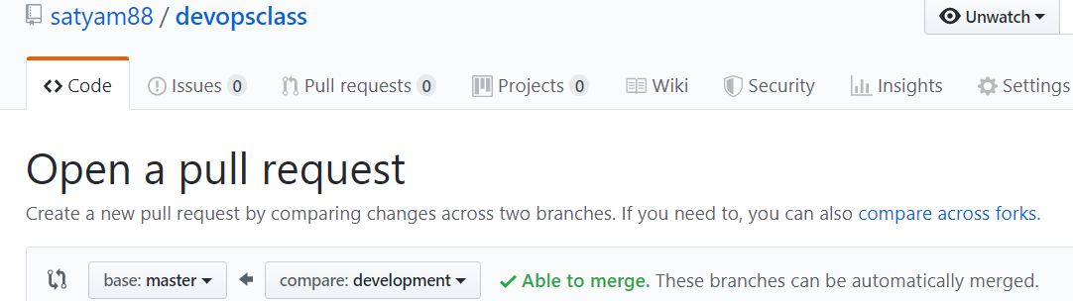
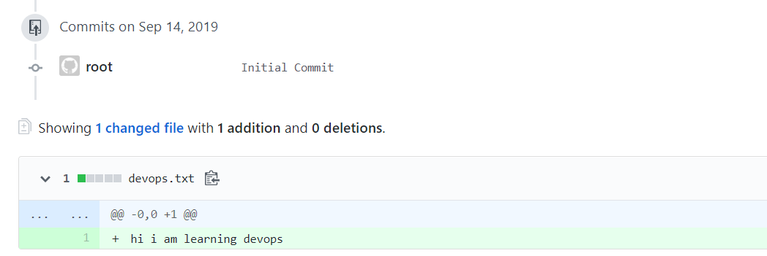
Making a Pull Request
Satyam Kumar Pandey
DevopsTraining@December2018
Notes:
Branches
Up until now we have not created any branch in Git. By default, Git commits go into the master branch.
What is a branch?
A branch is nothing but a pointer to the latest commit in the Git repository. So currently our master branch is a pointer to the second commit “demo.txt file is modified”.
Why are multiple branches needed?
Multiple branches are needed to support multiple parallel developments. Refer the image below to see how branches work.

Slide 18
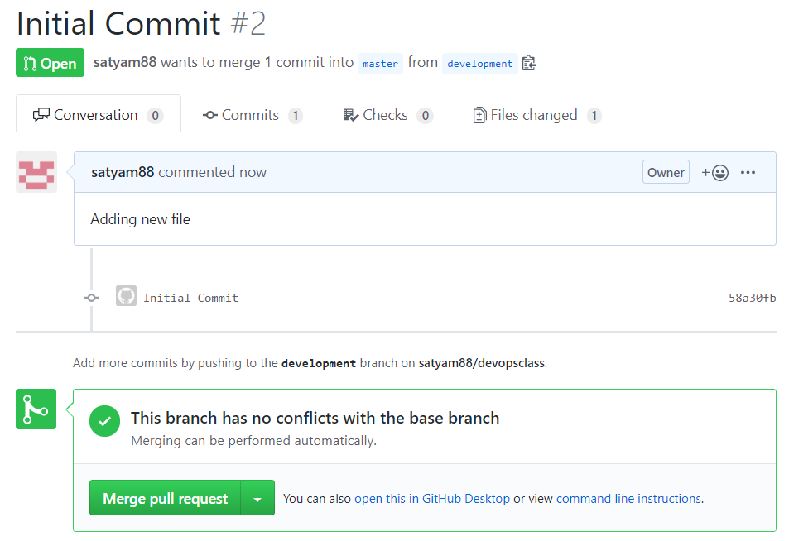
Making a Pull Request
Satyam Kumar Pandey
DevopsTraining@December2018
Notes:
Branches
Up until now we have not created any branch in Git. By default, Git commits go into the master branch.
What is a branch?
A branch is nothing but a pointer to the latest commit in the Git repository. So currently our master branch is a pointer to the second commit “demo.txt file is modified”.
Why are multiple branches needed?
Multiple branches are needed to support multiple parallel developments. Refer the image below to see how branches work.

Slide 19
Git Amend
The git commit --amend command is a convenient way to modify the most recent commit.
It lets you combine staged changes with the previous commit instead of creating an entirely new commit.
It can also be used to simply edit the previous commit message
#git add –all ; git commit –m “hello”; git push origin prod
#git add –all
#git commit –amend
#git push origin prod –f
Satyam Kumar Pandey
DevopsTraining@December2018

Slide 20
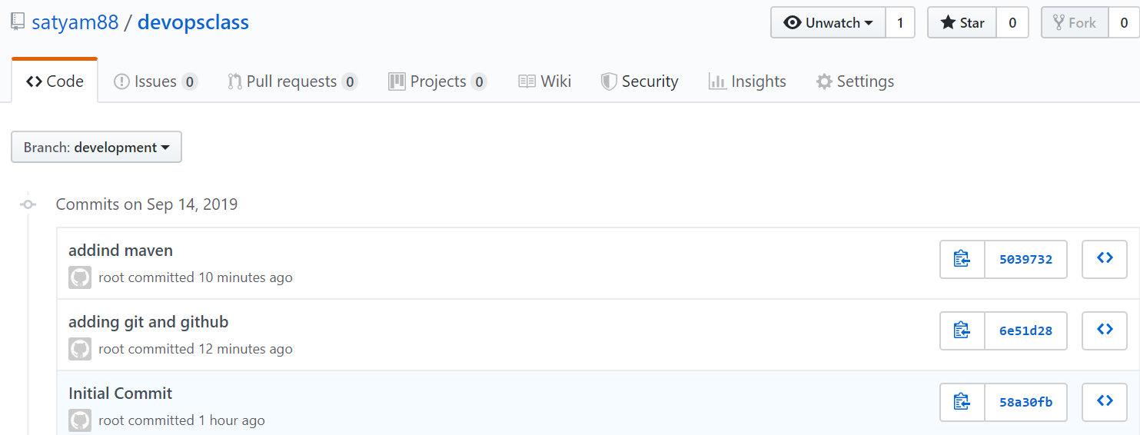
Merging Multiple Git Commits
Satyam Kumar Pandey
DevopsTraining@December2018
Notes:
Branches
Up until now we have not created any branch in Git. By default, Git commits go into the master branch.
What is a branch?
A branch is nothing but a pointer to the latest commit in the Git repository. So currently our master branch is a pointer to the second commit “demo.txt file is modified”.
Why are multiple branches needed?
Multiple branches are needed to support multiple parallel developments. Refer the image below to see how branches work.

Slide 21
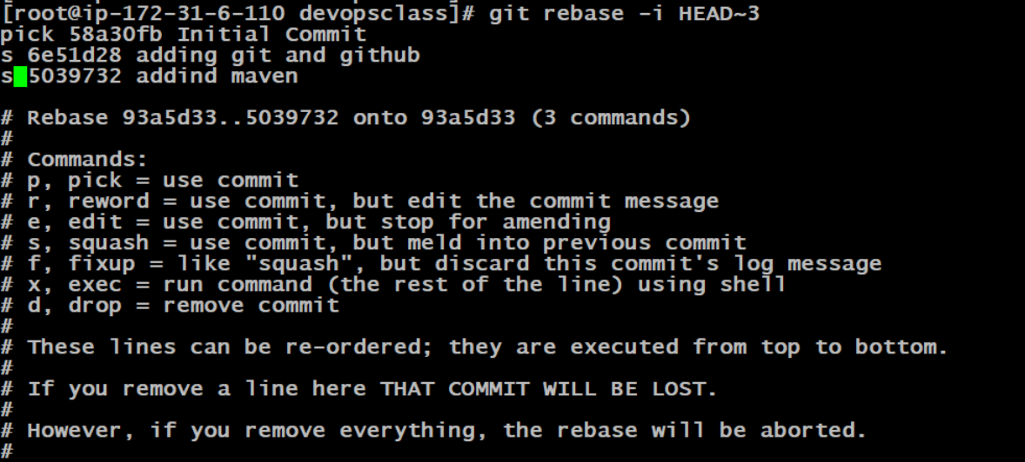
Pushing Source Code to Github Repository
Satyam Kumar Pandey
DevopsTraining@December2018
Notes:
Branches
Up until now we have not created any branch in Git. By default, Git commits go into the master branch.
What is a branch?
A branch is nothing but a pointer to the latest commit in the Git repository. So currently our master branch is a pointer to the second commit “demo.txt file is modified”.
Why are multiple branches needed?
Multiple branches are needed to support multiple parallel developments. Refer the image below to see how branches work.

Slide 22
Version Control With Git
Working on Branch !
Merge
Conflicts
Version control systems are all about managing contributions between multiple distributed developers. Sometimes multiple developers may try to edit the same content.
If Developer A tries to edit code that Developer B is editing a conflict may occur.
To alleviate the occurrence of conflicts developers will work in separate isolated branches.
The git merge command's primary responsibility is to combine separate branches and resolve any conflicting edits.
Satyam Kumar Pandey
DevopsTraining@December2018

Slide 23
Satyam Kumar Pandey
DevopsTraining@December2018

Slide 24
#git add –all
#git commit –m “Initial Commit”
#git push origin development
Every push will give me a new commit and all commit are not of use, then to select one commit out multiple you have to git rebase
#git rebase –i Head~3
#git push origin HEAD -f
#git add –all
#git commit –m “Initial Commit”
#git push origin development
From 2nd time onwards
#git add –all
#git commit --amend
#git push origin development –f
Every time if you push post amend it will rewite the commit id

